Slide 1
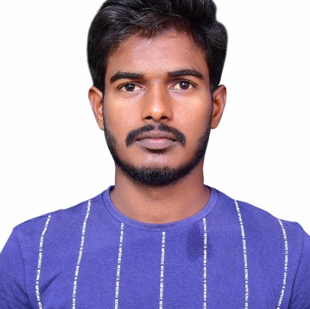
Prasad Reddy GS
Analyst/Software Engineer
Bachelor of Technlogy, Computer Science and Engineering : 2017 - 2021
Skills
Java​ | Java Basics, OOPS,​ Collections, Array.
Spring | Spring MVC, Spring JDBC, Spring Boot,Spring-ORM.
Angular | Basics,Directives,Forms,Pipes,Routing,Services.
Database​ | Postgres SQL
UI Tech​ | HTML 5 , JavaScript, CSS.
Tools | Eclipse,GitHub, Postman, Swagger, , Visual Studio Code, PG Admin 4.
Add On skills​ ​ | Immersive Learning​,Team Management.
Mumbai
Prasad-reddy.gs@capgemini.com
+91-8123470578
A4
Full Stack Developer
Good Knowledge in core java concepts.
Good in Spring Framework.
Good understanding of Agile.
Proficient in creating Single page Web Applications.
Hands on experience in developing web pages using HTML5, CSS, Object TypeScript, Good understanding of Document Object Model (DOM) and DOM Functions
Ready to learn new technologies and implement them for the future knowledge improvement.
Flight Management System.
Case study of Flight Management System along with Spring Boot,Swagger,HTML5,CSS and Angular used as User Interface.

